Slide 1
Cross National Study on Life Expectancy and its Determinants
Samyak Jain (21058)
April 2024

Slide 2
Table of Content
Introduction
Objectives
Findings
Conclusion
References

Slide 3
Introduction

Slide 4
Life expectancy stands as a fundamental metric reflecting the overall health and well-being of populations worldwide.
Drawing on a comprehensive dataset spanning various health indicators, GDP metrics, and educational parameters for a diverse array of countries (143), we embark on a systematic analysis to determine the influential metrics for life expectancy.
The significance of this research lies in its potential to inform evidence-based policymaking aimed at enhancing population health outcomes and promoting longevity globally.
Notes:
So, it is kind of an important study, as social interactions and mental health kinda link in together.

Slide 5
Objectives

Slide 6
Analyze the cross-national data to determine some factors which influence the life expectancy of a country.
Compare developed and developing countries on the basis of these factors.

Slide 7
Findings

Slide 8
Multiple Regression

Slide 9
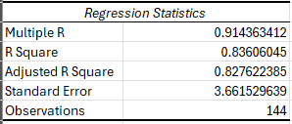
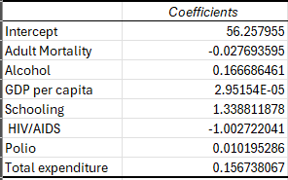
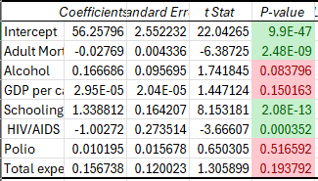
Interpretation
R2 is 0.84 or 84%
That means about 84% of variation in the dependent variable is explained by our independent variables.
The independent variables used are Adult Mortality, Alcohol consumption, GDP per capita, average number of years of schooling, HIV/AIDS deaths per 1000 births before 4 years of age, Polio, & government expenditure on health as a percentage of total govt. expenditure.
Coefficients of each variable are shown, these coefficients tell us how much of a change in the variable changes the dependent variable.
Most notable variables are Schooling and HIV/AIDS with the highest coefficients.
Out of these, only the variables corresponding to the green highlighted cells are of statistical significance, as their p value is less than 0.05.

Slide 10
Important Factors
Adult Mortality, Schooling & HIV/AIDS

Slide 11
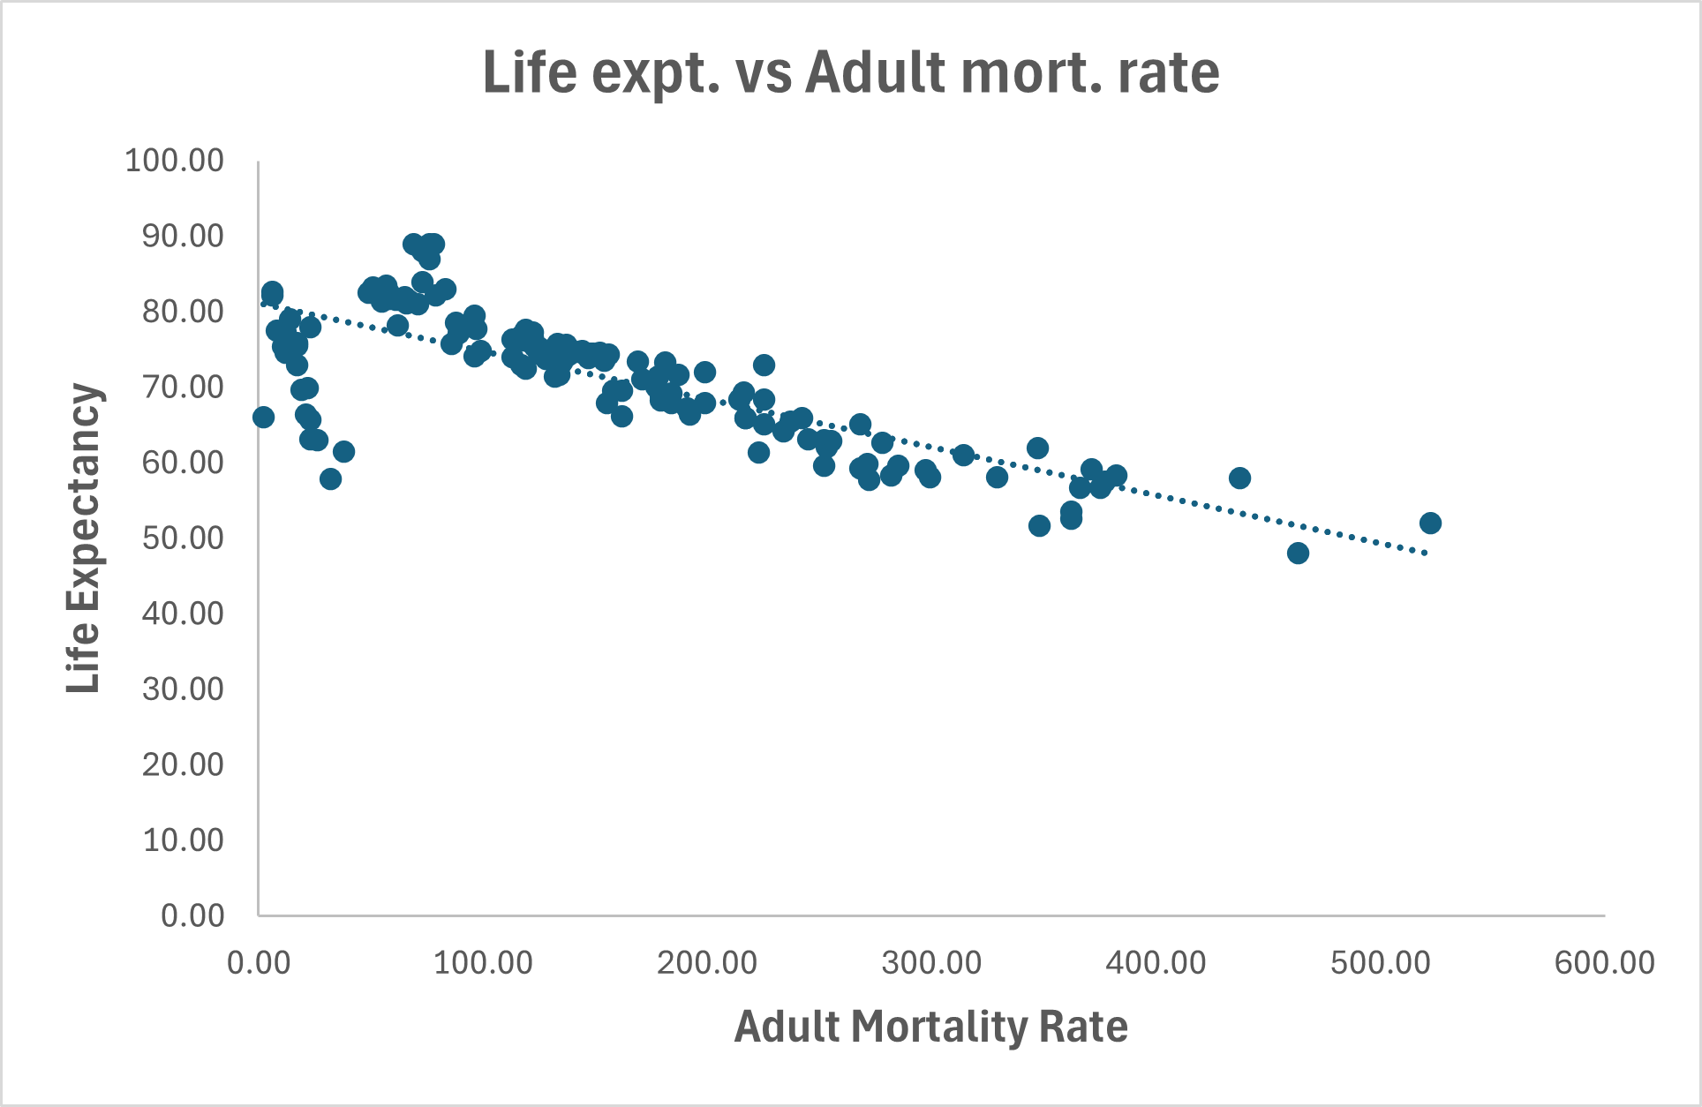
Adult Mortality Rate
Correlation of -0.78
Strong negative relation between the two, when adult mortality rate increases the life expectancy of the people of the country decreases and vice versa.

Slide 12
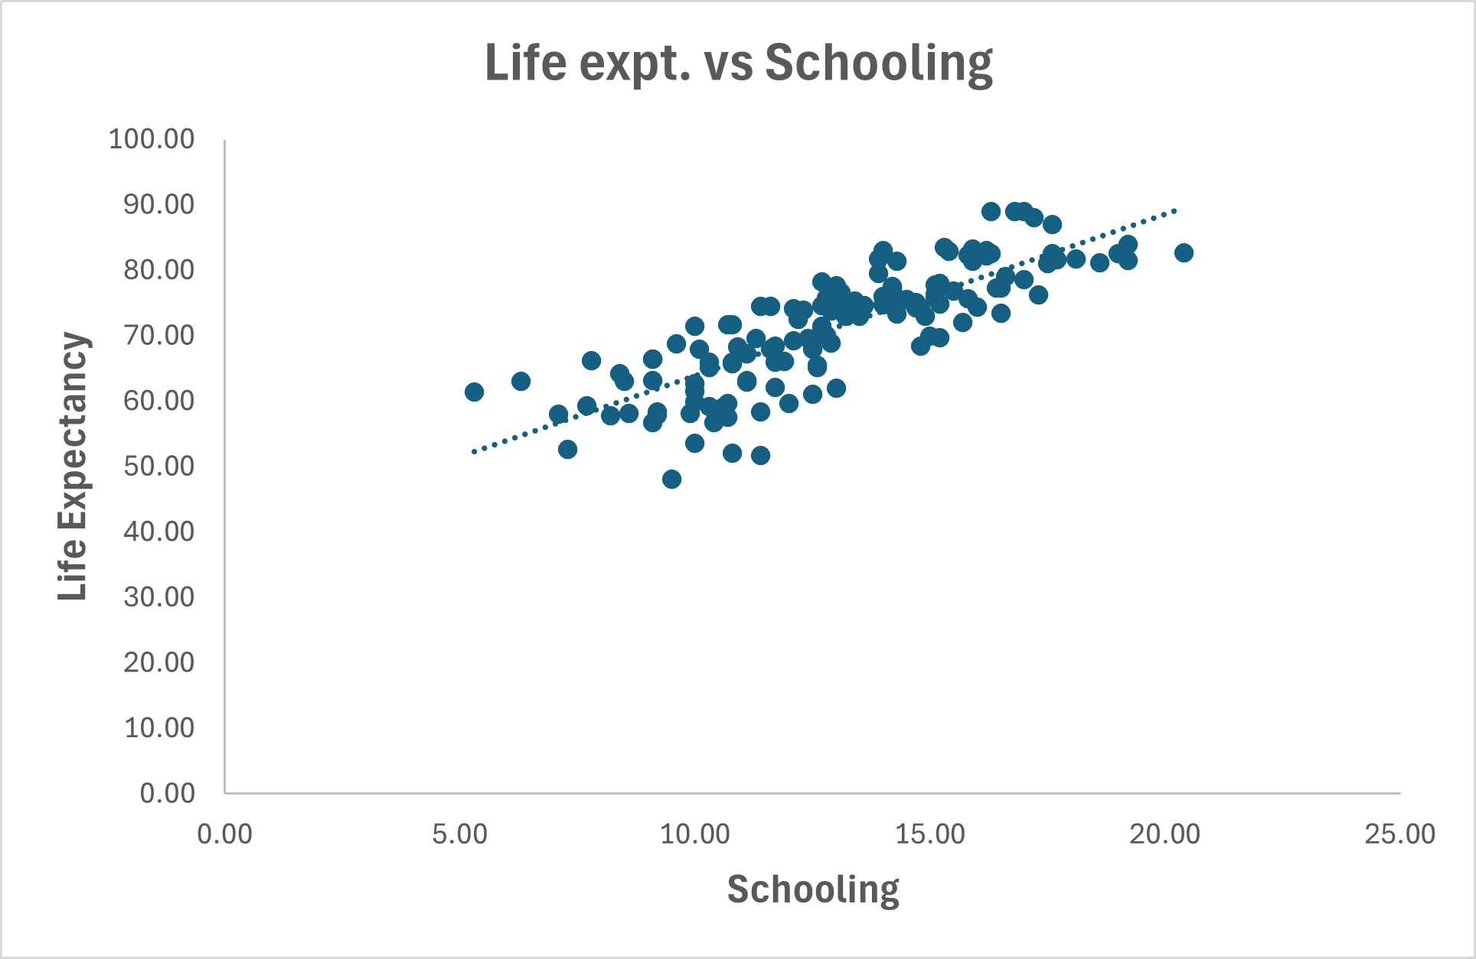
Average Number of years of Schooling
Correlation of 0.82
Strong positive relation between the two, when years of schooling increases the life expectancy of the people of the country also increases and vice versa.

Slide 13
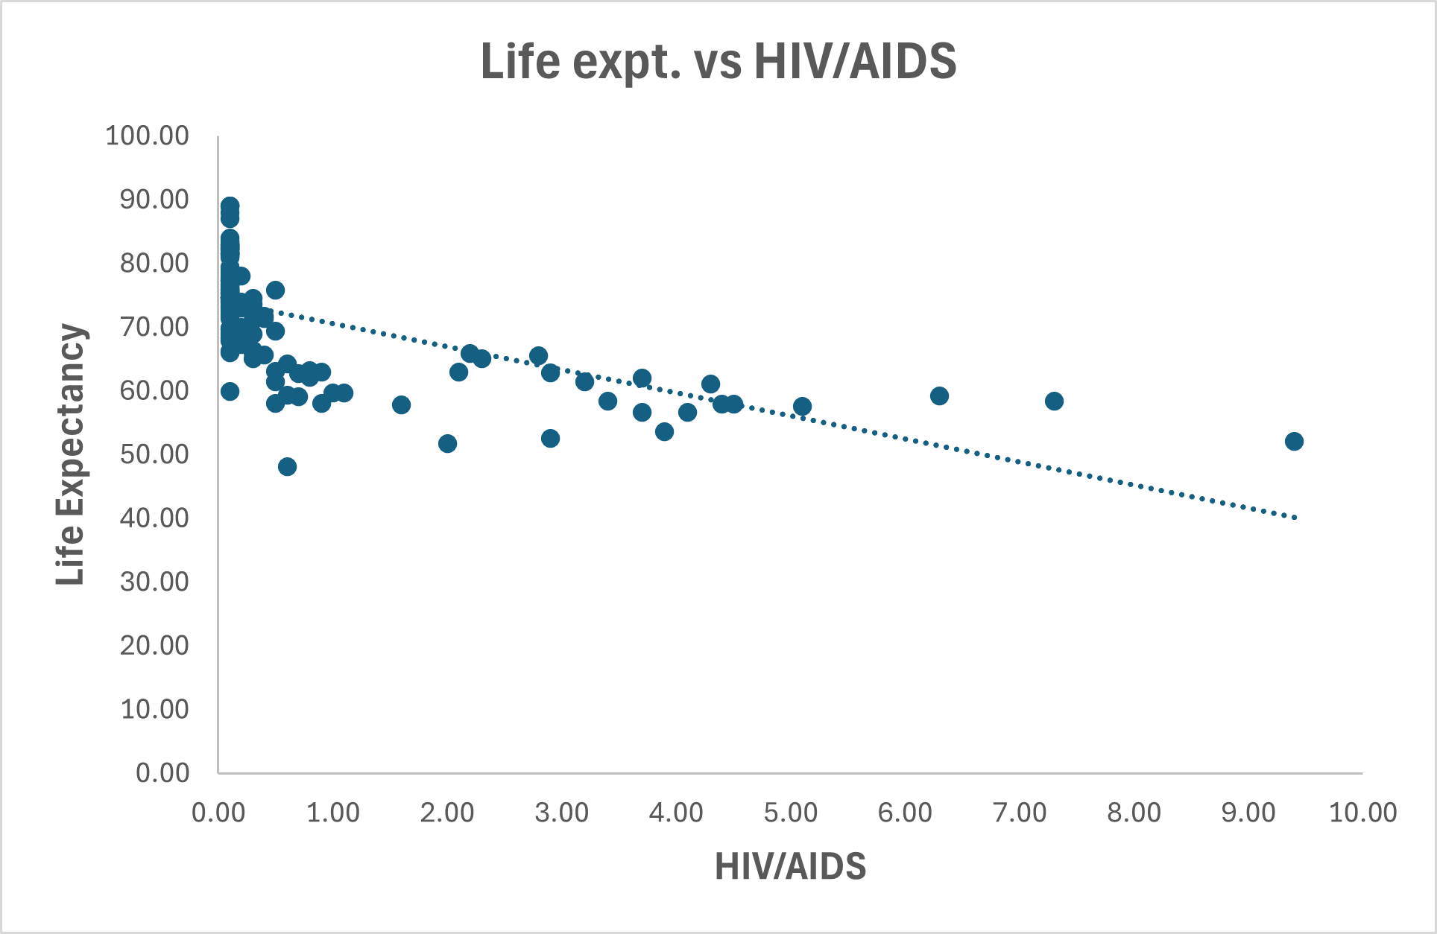
HIV/AIDS death per 1000 births up to the age of 4
Correlation of -0.62
Strong negative relation between the two, when deaths due to HIV/AIDS increases the life expectancy of the people of the country decreases and vice versa.

Slide 14
Comparing Developed and Developing Countries
On the basis of life expectancy and its important factors

Slide 15
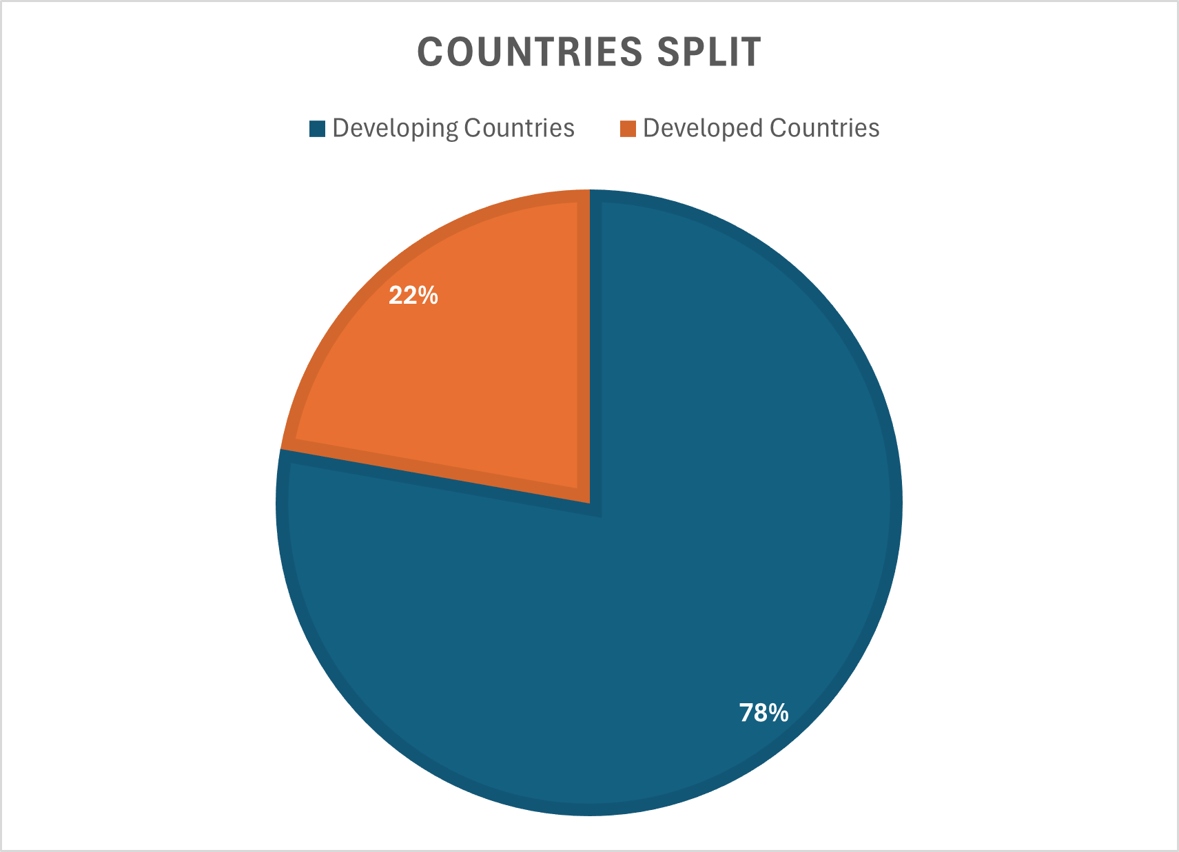
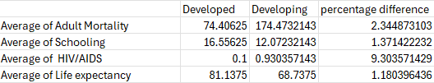
Comparison
Out of the 143 countries, 112 are developing (78%) and the rest 32 are developed (22%).
Keeping that in mind, here are some insights:
The average adult mortality rate of a developing country is 2.3x higher than that of a developed country.
People of developed country are 1.4x more educated.
A death due to HIV/AIDS among infants is 9x more likely in a developing country.
The average life expectancy of the developing nation is even lower than the lowest of the developed nations.
When directly comparing the averages, a person from developed country is expected to live 1.2x longer.

Slide 16
Conclusion

Slide 17
To conclude, Life Expectancy of the people of a country seem to be greatly linked with it’s Adult Mortality Rate, Number of years of schooling and HIV/AIDS death per 1000 births up to the age of 4. Though, there are more factors.
The overall quality of life, judging from the comparison, of the developing countries is far behind that of developed countries. The focus of developing countries should be to work on these factors to improve the life expectancy and hence overall quality of life of their people.

Slide 18
References

Slide 19
Life Expectancy (WHO) by KUMARRAJARSHI.
(https://www.kaggle.com/datasets/kumarajarshi/life-expectancy-who)
Human Development Reports by UNDP.
(https://hdr.undp.org/data-center/specific-country-data#/countries/USA)
Population change - year 2014 by Czech Statistical Office.
(https://www.czso.cz/csu/czso/ari/population-change-4-quarter-2014-q91zsn7atp)
World Development Indications by The World Bank.
(https://datatopics.worldbank.org/world-development-indicators/)
Determinants of life expectancy at birth: a longitudinal study on OECD countries by Paolo Roffia, Alessandro Bucciol, and Sara Hashlamoun.
(https://www.ncbi.nlm.nih.gov/pmc/articles/PMC9650666/#:~:text=From%20the%20literature%20we%20identified,(7)%20other%20external%20factors)
Factors effecting life expectency in developed and developing countries of the world (An approach to available literature) by Alamgir Khan, Dr. Salahuddin Khan, Manzoor Khan.
(https://www.researchgate.net/publication/310240265_Factors_effecting_life_expectancy_in_developed_and_developing_countries_of_the_world_An_approach_to_available_literature)
Do New Drugs Increase Life Expectancy? A Critique of a Manhattan Institute Paper by Dean Baker, PhD and Adriane Fugh-Berman, MD.
(https://www.researchgate.net/publication/24221574_Do_New_Drugs_Increase_Life_Expectancy_A_Critique_of_a_Manhattan_Institute_Paper)

Slide 20
Thank You

